Slide 1

Virtual Machines and Containers
Analysis
Adel Belkhiri Michel Dagenais
May 5, 2017
Polytechnique Montréal
Laboratoire DORSAL
Notes:
Good morning ladies and gentelmen. My name is Adel Belkhiri. I’m a Phd student in the Dorsal Lab and I’m delighted today to talk to you about my current research topic which is the analysis of virtual machines and containers.

Slide 2

Agenda
Introduction
Literature review
– Virtual Machines Analysis
– Containers Analysis
Future Work
Conclusion
1
POLYTECHNIQUE MONTREAL – Adel Belkhiri
Notes:
Since this is my first presentation in the progress meeting, I chose it to be simple. So my presentation is divided into 4 parts. In the first part I will introduce some background concepts that are related to my research topic. In the second part, I’ll present some works done in the field of virtual machines and containers analysis. In the third part, I’ll present my future work. And finally, I will finish this presentation by a conclusion.

Slide 3
Introduction
What is tracing ?
    “Tracing is a technique used to understand what goes on in a running software system. The software used for tracing is called a tracer, which is conceptually similar to a tape recorder”
Ref : https://lttng.org/docs/v2.9/#doc-what-is-tracing
    A trace consists of chronologically ordered list of events characterized by a name, a time stamp and a payload.
    Many tracers exist for Linux :
    lttng
    ftrace
    strace
    perf
2
POLYTECHNIQUE MONTREAL – Adel Belkhiri
Notes:
Tracing is often compared to logging. However, tracers and loggers are two different tools, serving two different purposes. Tracers are designed to record much lower-level events that occur much more frequently than log messages. The list of recorded events are saved in a trace file.

Slide 4
Introduction
    Virtualization is a broad term that refers to the abstraction of the resources of one physical machine in order to share them between many VMs (Virtual Machines).
    Virtualization is the base building layer of cloud computing services.
    Evolution of virtualization technologies :
– Full Virtualization
– Para-Virtualization
– Hardware-Assisted Virtualization
POLYTECHNIQUE MONTREAL – Adel Belkhiri
3
Notes:
Virtualization is a broad term that refers to the abstraction of computer resources. Here we use this term to speak about the software layer that allows one computer to do the job of many, by sharing the resources of a single hardware across multiple environments. Virtualization draw much attention with the emerging interest that companies have in cloud computing. Virtualization technologies have seen so many improvements over the time and all of them intend to reduce the induced overhead. There is three generations of virtualization technologies : the first one is the full virtualization which consists of emulating all the hardware, the CPU included. The guest OS doesn't see that it is running in an emulated environment and a big part of its instructions are trapped by the hypervisor and translated. The second generation is the Para-Virtualization In which The guest OS is aware that it is running in an emulated environment. It uses a specialized API and drivers to talk to the hypervisor in order to execute its privileged instructions. In the third generation, which is the The hardware Assisted-Virtualization, the hypervisor uses processor extensions like Intel PT for example to intercept and emulate privileged operations of the OS guest. This approach simplifies a lot the hypervisors’ job and reduces the performance cost induced by the virtualization layer.

Slide 5
Introduction
Why it is important to analyze VMs ?
    We need to analyze VMs to :
      – Diagnose unexpected delays / bottlenecks.
      – Make sure that the performance of tenant’s instances meets the SLA (Service Level Agreement).
      – Be able to detect vulnerabilities and security issues.
      – Estimate the cost of the virtualization layer (indirect access to the hardware, instructions translations, frequent context switching, etc.).
POLYTECHNIQUE MONTREAL – Adel Belkhiri
4
Notes:
Cloud services providers are always looking for efficient monitoring tools that allow them to monitor and analyze VMs performance and here in the Lab we are also working to find new techniques and approaches to analyse VMs ... But we may ask ourselves, why it is important to trace and analyze VMs ? The answer for this question is .. , first, to be able to diagnose the unexpected delays that may occur when processes are executed inside a VM. An accurate diagnosis allow us to eliminate potential bottlenecks like resource overcommitment and to improve the performance of the VMs. Second, by tracing a VM we can discover and fix potential vulnerabilities and security issues which may expose the applications running inside it to attacks. Estimating the cost of the virtualization layer is another reason for analyzing VMs. For example we can estimate the time needed by a VM to access a given shared resource or we can estimate the frequency of vCPU context switching, etc. Cloud clients also need to analyze their VMs to make sure that the resource that they provisioned meet their SLA. Cloud users may experience performance degradation due to resource sharing and interferences between VMs. Experiences show that execution times for identical tasks varies when VM are competing for the same resources.

Slide 6
Literature review
    Gebai and al. 2014 :
      Average steal time is not sufficient to recover the cause of preemption of tasks running in VMs.
      Correlating and synchronizing kernel traces recorded simultaneously on the host and on the VMs.
      Detecting competing threads in distinct VMs.
    Suchakra and al. 2016 :
      HAVAna (Hardware Assisted Virtual machine Analysis algorithm): A tool to gather hardware trace packets from CPU hardware acceleration extension (Intel PT).
Detect different vCPU states, dissect processes inside VMs and uncover resources contentions between them (without querying guests).
POLYTECHNIQUE MONTREAL – Adel Belkhiri
5
Notes:
In my literature review section, I chose to present to you few research works related to VMs and containers analysis. Most of the work was done by my colleagues here in our lab.
So the first work was done by Mohamed Gebai and al and was published in 2014. The title of his paper is “Fine-grained preemption analysis for latency investigation across virtual machines”. They propose a method to retrieve the preemption state for the vCPU by using traces from the host kernel and each VM. With their method they were able to detect the root cause of the the preemption whether it is VM thread or a host thread. In order to implement their method they synchronized the traces they got from tracing virtual machines with the timestamps of the traces they got from the host. The synchronized traces were then used to build a control flow of each thread inside each VM and the host separately. They, also, proposed a method to search through all threads inside the host and the VM and find preemption states.
The second work that I’ll talk about, was done by Suchakra and al. in 2014. They proposed an algorithm called Havana (Hardware Assisted Virtual machines analysis algorithm). The first goal of their algorithm was to detect the different states that a vCPU pass through when executing processes and the second goal was to uncover the resources contentions between processes inside different VMs. Their method doesn’t need to trace VM but it uses the trace packet information gathered from the CPU extensions.

Slide 7
Literature review
    Nemati and al. 2016 :
      A host-only tracing based tool to analyze and detect the state of each vCPU and why it is in that state.
      Using hardware virtualization capabilities to profile threads inside VMs.
    Dean and al. 2016 :
      PerfCompass : An online performance anomaly fault localization and inference tool.
Distinction between internal faults which have local impact on the system and external faults which have global impact.
POLYTECHNIQUE MONTREAL – Adel Belkhiri
6
Notes:
Nemati and al proposed a new method to detect the state of the vCPU of a VM just by tracing the host kernel. They supposed that internal access to the VM is not possible because of confidentiality issues and because of the extra overhead it induces. Their method is based on the use of INTEL and AMD processor and they were able to detect vCPU states by using events like sched_switch, sched_wakeup, kvm_enty and kvm_exit. They used also some informations that are stored in the Virtual Machine Data Structure like the exit reason related to the kvm_exit. They also proposed a method to profile threads inside the VM by instrumenting KVM and dumping the values process ID and thread ID from the Virtual Machine Data Structure at each thread creation. Their method was used to undercover the root causes of latencies in some use cases.
The other work was done by Dean and al in 2016. They proposed a tool called PerfCompass which is able to diagnose faults that may occur in cloud services. Their method group system calls based on the process/thread ID to form multiple executions units and, then, it performs a change detection over system call execution time or system call frequency to detect whether an execution unit is affected by a fault. Their method make a distinction between internal faults and external faults. When an external fault occur it directly affects all running execution units simultaneously. In contrast, an internal fault occurs it only directly affects a subset of execution units. Dean and al said that this distinction between the two types of the fault is important to achieve an efficient performance anomaly correction of the fault.

Slide 8
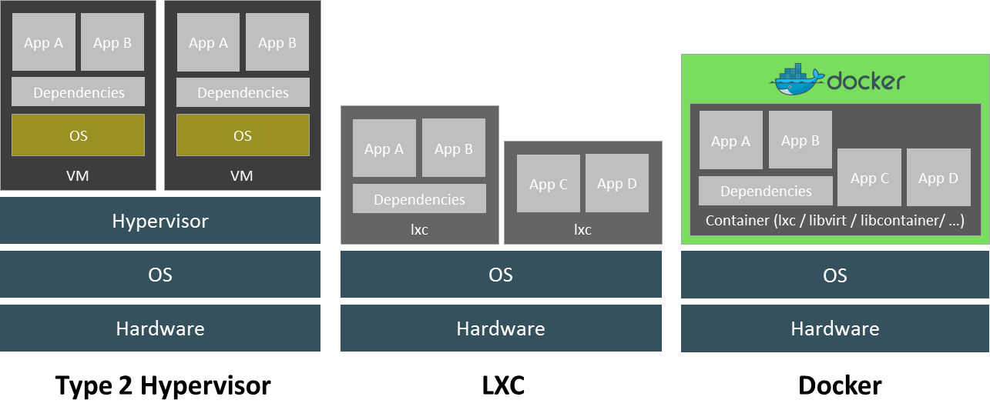
Containers vs VMs
    Containers :
      Share the same OS kernel as the host.
      Are used to isolate the application and its dependencies and to lock them inside a self-contained unit.
Ref : http://embedded-computing.com/eletter-products/virtualization-redefined/
POLYTECHNIQUE MONTREAL – Adel Belkhiri
7
Notes:
In this section, i’ll speak about containers. The container-based virtualization is an OS-level virtualization method for deploying and running distributed applications without launching an entire VM for each application. Instead, multiple isolated systems, called containers, are run on a single host and they all access one single kernel. So the main difference between a Container and a VM is that the container share the host OS kernel whereas the VM has its own OS.

Slide 9

Containers vs VMs
    Compared to VMs, containers are :
          Lightweight
Faster to boot and to migrate
    Less overhead
    Security oriented (cgroups, namespaces, etc.)
    Docker : a container’s success story :
          It is getting more popularity in private and public cloud (Amazon, Azure, etc.).
It makes the application more portable by abstracting more the networking, storage, and OS details.
POLYTECHNIQUE MONTREAL – Adel Belkhiri
8
Notes:
Because they share the same kernel with the OS host, containers present many advantages Compared to VMs they are more lightweight, faster to boot and to migrate from one host to another, and they induce less overhead. Containerization gained much attention recently thanks to the success of Docker with makes the applications more portable.

Slide 10
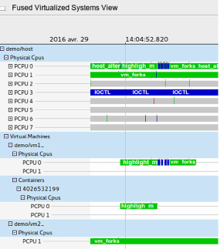
Literature review
    Biancheri and al. 2016 :
      FVS (Fused Virtualized Systems) : Correlating and synchronizing kernel traces recorded simultaneously on the host and on the VMs.
      A Trace Compass view that displays an overview of the full hierarchy of a virtualized system including VMs, nested VMs and Containers.
Fig.: Fused Virtualized Systems view
POLYTECHNIQUE MONTREAL – Adel Belkhiri
9
Notes:
Biancherie and al. Developed a tool named Fused Virtualized Sytems. The goal of this tool is to dissociate and to show all the virtualization layers in a Virtualized System. Their work was based on tracing the kernel host and the Vms and synchronizing those traces. They developed a view in trace compass that shows the full hierarchy of a virtualized system including VMs, Nested VMs and Containers.

Slide 11
Future Work
    Tracing and analyzing the interactions between VMs and Containers to better understand cloud services failures and latencies.
    Developing new techniques to monitor “native cloud” applications. VMs’ monitoring tools are not suitable in this context since microservices have to stay lightweight, and unburdened by agent.
    Since deploying containers on top of VMs seems to be the most popular (SaaS), there is a need for new methods to investigate the performance of processes inside them.
POLYTECHNIQUE MONTREAL – Adel Belkhiri
10
Notes:
What i’m planing to do in my future work is to analyse the interactions between VMs in order to uncover the root causes of latencies in cloud services. Currently I’m working on Vms and containers live migration and I’m trying to find a way to predict in advance its success or failure. I’ll also work on developing monitoring tools that are suitable to the containers specificities.

Slide 12
Conclusion
    Cloud shifts the way computing resources are consumed – Conventional monitoring tools are not appropriate to assess the performance of cloud-delivered services.
    Current trends are to move from applications’ monolithic architecture to microservices architecture – Monitoring those applications became a challenge (collecting, synchronizing and analyzing monitoring data).
    Docker is driving companies to get more interest in container’s technologies – There is a need for an intelligent instrumentation to allow administrators to see inside them from the outside.
POLYTECHNIQUE MONTREAL – Adel Belkhiri
11

Slide 13
Questions?
adel.belkhiri@polymtl.ca
POLYTECHNIQUE MONTREAL – Adel Belkhiri

Slide 14
References
    Gebai, M., Giraldeau, F., & Dagenais, M. R. (2014). Fine-grained preemption analysis for latency investigation across virtual machines. Journal of Cloud Computing: Advances, Systems and Applications, 3(1), 41.
    H. Nemati and M. R. Dagenais, "Virtual CPU State Detection and Execution Flow Analysis by Host Tracing," 2016 IEEE International Conferences on Big Data and Cloud Computing (BDCloud), Atlanta, GA, 2016, pp. 7-14.
    S. D. Sharma, H. Nemati, G. Bastien and M. Dagenais, "Low Overhead Hardware-Assisted Virtual Machine Analysis and Profiling," 2016 IEEE Globecom Workshops (GC Wkshps), Washington, DC, 2016, pp. 1-6.
    D. J. Dean, H. Nguyen, P. Wang, X. Gu, A. Sailer and A. Kochut, "PerfCompass: Online Performance Anomaly Fault Localization and Inference in Infrastructure-as-a-Service Clouds," in IEEE Transactions on Parallel and Distributed Systems, vol. 27, no. 6, pp. 1742-1755, June 1 2016.
POLYTECHNIQUE MONTREAL – Adel Belkhiri

